Slide 1
RESPIRATORY FAILURE
Dr Firezer- PCHR3

Slide 2
Outline
DEFINITION
Etiology
Management
Common respiratory problems in children

Slide 3
Respiratory failure
Inability of the lungs to provide oxygen or remove CO2.
Two types; 1. hypoxic RF 2. ventilatory RF.

Slide 4
Respiratory distress
Signs and symptoms of an abnormal respiratory pattern.
Nasal flaring, chest wall retractions, fast breathing, grunting, stridor…
Can be pulmonary or non pulmonary etiologies.

Slide 5
DISTRESS
Fast breathing –
age 0- 2 months ----- > 60/minute
2-12 months------ > 50/minute
1yr – 5 years------- > 40/minute
5yr – 12 years------ > 30/minute
Presence of retractions
Apnea
Cyanosis
Could be due to pulmonary and non-pulmonary etiologies.

Slide 6
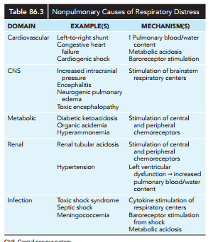

Slide 7
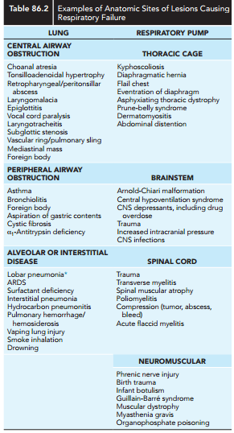

Slide 8
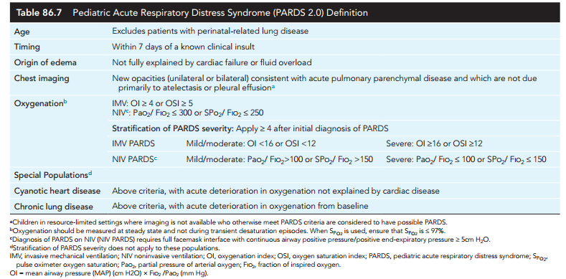

Slide 9
Monitoring
Clinical evaluation
Pulse oximetry
ABG
Oxygenation & ventilation assessment( OI,OSI, P/F, S/F)

Slide 10
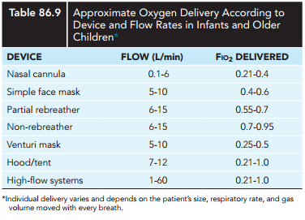
Management
Oxygen administration
Various ways of delivering oxygen.
Fio2 = 21%+ flow*3

Slide 11
Management con.
Positive pressure respiratory support
Non invasive ( CPAP , BIPAP)
and invasive( ENDOTRACHEAL INTUBATION)- impending respiratory failure.
ETT size estimation= age/4 + 4.

Slide 12
SOAPME
S- SUCTION
O- OXYGEN,BAG,MASK
A- AIRWAY: ETT,STYLET,ORAL AIRWAY,LARYNGOSCOPE
P-PHARMACOLOGY,MEDICATIONS
ME- MONITORING EQUIMENT:

Slide 13
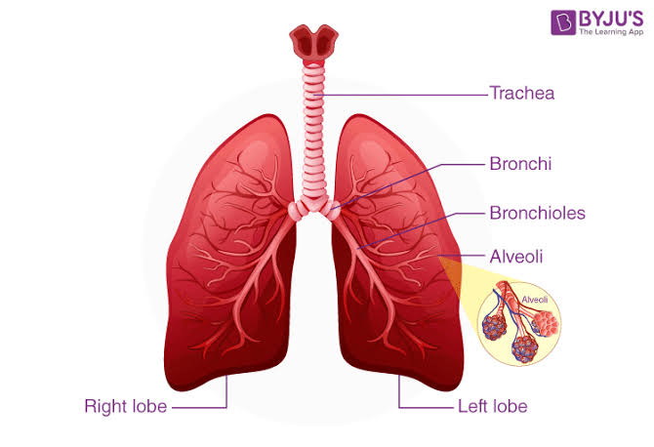
Common Respiratory Problems

Slide 14
Case
A two years old child presented to the emergency ward with fast breathing ,grunting and high grade fever of two days duration . He had antecedent history of upper respiratory tract infection
On examination : V/S PR : 145 /min regular ,full in volume ,RR: 56/min ,SaO2: 88% room air
Nasal flaring , intercostal subcostal retraction
Bronchial breath sound over the right upper lobe

Slide 15
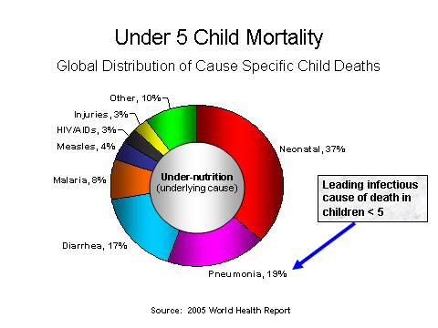
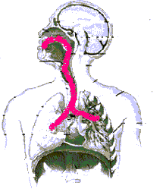

Slide 16
Extent of the problem
In Ethiopia it accounts for 28% of U5C deaths.
It is estimated that 65% of these pneumonia deaths could be prevented if appropriate preventive and treatment interventions were applied at national scale.
Treatments such as oral antibiotics, in addition to the effective prevention interventions of breastfeeding and adequate complementary feeding.

Slide 17
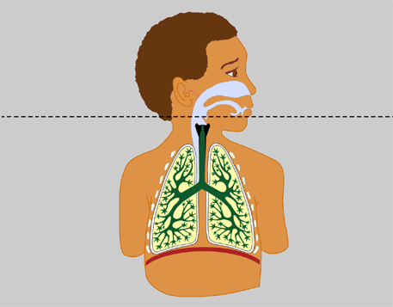
Defence of Respiratory Tract
Mechanical
Filtration
Mucociliary clearance
Reflex
Innate defence
airway antimicrobial factors
Alveolar macrophages
Neutrophils
Adaptive defence
Secretaory IgA
IgG

Slide 18
Definition of pneumonia
Pneumonia is a lung parenchymal infection
Classification of pneumonia is based on ;
place of acquisition
clinical symptoms/signs
patterns on chest radiograph
Etiology of pneumonia
lung pathology

Slide 19
Etiology
Depends upon
Age
Clinical setting (community, hospital)
Local epidemiology (RSV, influenza epidemics)
Relevant exposure ( contaminated water, animals)
Immunostatus

Slide 20
Etiology of pneumonia
Age related etiology of pneumonia in immunocompetent children : AAP Pediatric Pulmonology
< 2months Group b streptococcus Staphylococcus aureus Listeria Monocytogens | 2-12 months Pneumococcus Virus :RSV Parinfluenza ,Influenza Adenovirus hMPV chlamydia Trachomatis pertussis | 1-4 years Pneumococcus, H.influenza, Pertussis ,St.Aureus Virus :parainfleunza,influenza,RSV,Adenovirus ,hMPV, Mycoplasma M.Tuberculosis | 5-12years Mycoplasma St.pneumoccocus, H.influenza Viruses | ≥12 years Mycoplasma C.pneumoniae Group A streptoccocus M.Tb

Slide 21
Routes of infections
Inhalation
Aspiration
Direct inocculation
Blood borne

Slide 22
Pathophysiology
Risk factors
Lack of EBF
Undernutrition
Indoor air pollution
Low birth weight
Overcrowding
Lack of vaccination
Malnutrition,HIV infection

Slide 23
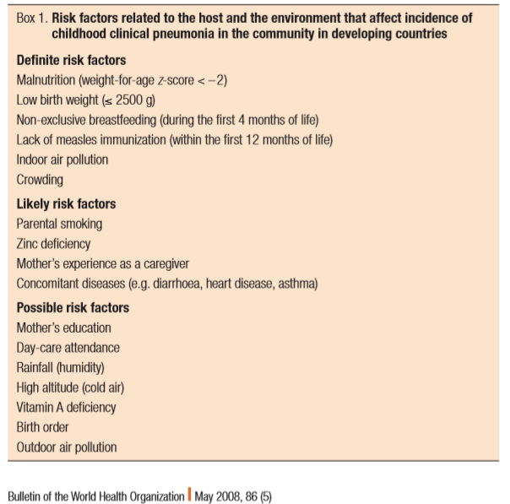

Slide 24
Clinical presentation
Viral : Wheezing ,tachypnea, rhinorrhea
Bacterial :High grade fever, Cough ,Tachypnea, Coarse crackles ,Bronchial breath sounds
Atypical : extrapulmonary manifestations, low grade fever

Slide 25
Laboratory diagnosis
CBC:
High neutrophil count in bacterial infection
High lymphocyte count : Viral, B.pertussis , M.Tuberculosis
Raised acute phase reactant
CRP>40mg/dl
Procalcitonin
Blood culture :
20% positive

Slide 26
Immunoassays ;
Comparison from acute to convalescent stage
IgM level
Cold agglutinins
Multiplex PCR

Slide 27
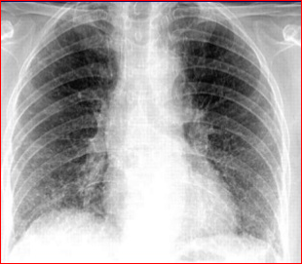
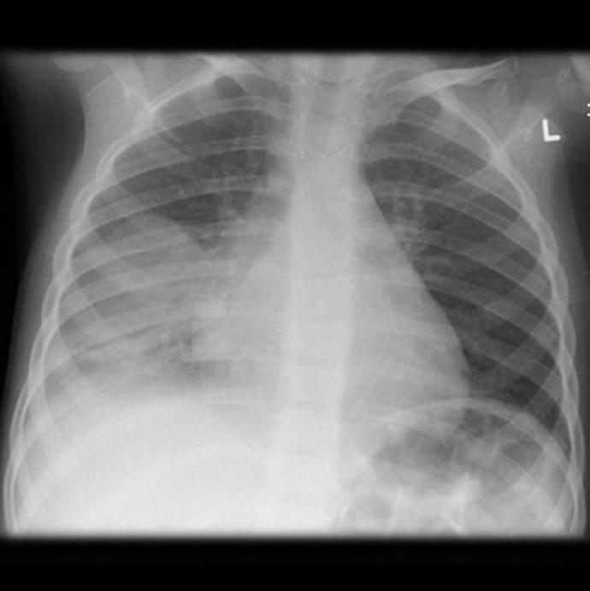
Interstitial infiltrate
Lobar pneumonia

Slide 28

Types of Pneumonia
Community-acquired (CAP)
Nosocomial or hospital-acquired .
Recurrent pneumonia is defined as 2 or more episodes in a single yr or 3 or more episodes ever, with radiographic clearing between occurrences.
An underlying disorder should be considered if a child experiences recurrent bacterial pneumonia.

Slide 29
Causes of recurrent pneumonia
Hereditary Disorders: Cystic fibrosis, Sickle cell disease
Disorders of Immunity: AIDS, agammaglobulinemia
Disorders of Leukocytes: Chronic granulomatous disease
Hyperimmunoglobulin E syndrome (Job syndrome)
Disorders of Cilia: Immotile cilia syndrome, Kartagener syndrome
Anatomic Disorders: Sequestration, Esophageal reflux, Foreign body, Tracheoesophageal fistula ,Gastroesophageal reflux, Bronchiectasis.

Slide 30
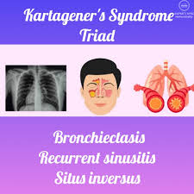

Slide 31
Complications
Complications of pneumonia are usually the result of direct
spread of bacterial infection within the thoracic cavity or
hematogenous spread.
Abscess
Pleural effusion, empyema
Bronchopleural fistula
Cutaneous fistula
Pneumothorax
Hematogenous spread (meningitis, suppurative arthritis, and osteomyelitis)
Bronchiectasis
Pericarditis

Slide 32
Principles of treatment
Appropriate antimicrobial agents
Decrease fever
Encourage feeding
Increase fluid intake
Arrange follow-up

Slide 33
No improvement or slow resolution
complications, such as empyema
bacterial resistance
nonbacterial etiologies such as viruses and aspiration of foreign bodies or food;
bronchial obstruction from endobronchial lesions, foreign body, or mucous plugs
pre-existing diseases such as immunodeficiencies
other noninfectious causes (including bronchiolitis obliterans, eosinophilic pneumonia)
A repeat chest x-ray is the 1st step in determining the reason for delay in response to treatment.

Slide 34
Key interventions for pneumonia
Exclusive breastfeeding
Adequate complementary feeding
Immunization
Vitamin A supplementation
Antibiotic treatment
Prevention of indoor air pollution

Slide 35
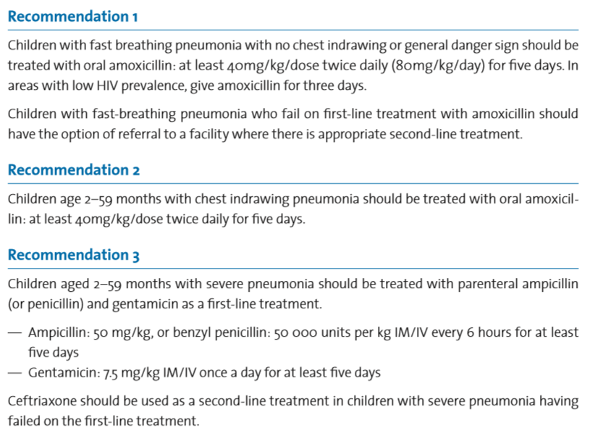
WHO new guideline

Slide 36
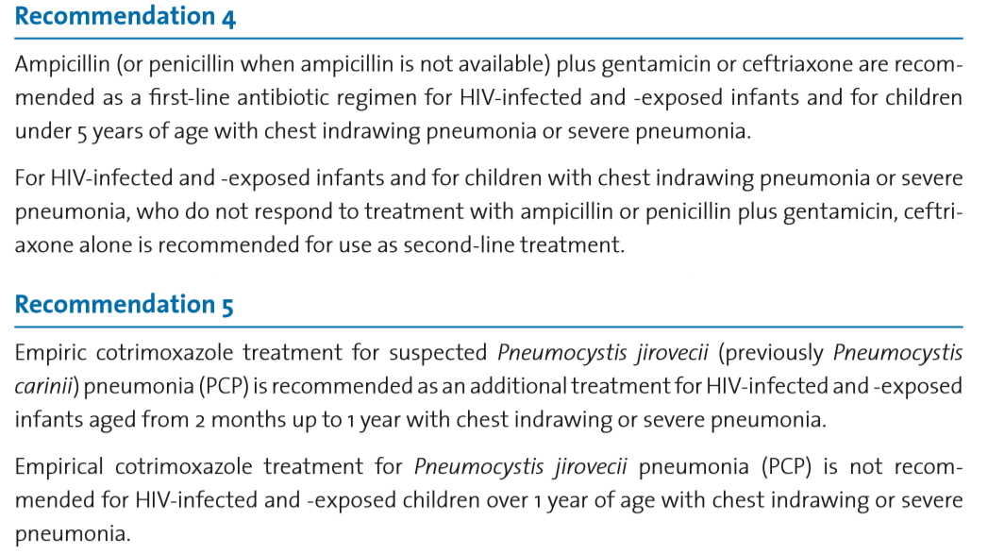

Slide 37
Upper airway obstruction.

Slide 38
Upper Airway vs. Lower Airway Obstruction
Upper airway obstruction present as inspiratory stridor
Produced by turbulent airflow through large airways
Normal respiratory volume of air moves through narrowed airways
Lower airway obstructive processes present as expiratory wheezing.

Slide 39
Introduction
• Upper airway obstruction is a common cause of pediatric emergency department visits, accounting for approximately 15% of all critically ill patients.
• Infectious etiologies account for 90% of these, with viral croup accounting for 80%.
- The most common cause of upper airway obstruction in children is croup

Slide 41
Unique features of the pediatric airway
1. Tongue is relatively large in proportion to oral cavity
2. Infants <2 months of age are obligate nose breathers
3. Trachea is smaller and shorter than that of adults
4. Larynx is relatively anterior and high: C2 in neonate, C3-4 in child, C5-6 in adult
5. Chest wall of infants relatively weak and unstable
6. Immunologic immaturity leads to increased susceptibility to respiratory infections
7. Developmental immaturity leads to increased susceptibility to foreign body aspiration

Slide 42
Causes of Upper Airway Obstruction in Children
Congenital
Aquired
Iatrogenic (subglottic stenosis)
Infections
Foreign Bodies
trauma

Slide 43
C/F
Inspiratory stridor:
Stridor is a harsh, high-pitched, musical sound produced by turbulent airflow through a partially obstructed airway
Stridor, which is derived from Greek, meaning
“creaking,” is caused by rapid turbulent flow through a narrowed airway

Slide 44
Common Causes of Stridor
Children < 6 months of age
Laryngomalacia
Tracheomalasia
Vocal cord paralysis
Children > 6 months of age
Viral Croup
Epiglottitis
Retropharyngeal abscess
Bacterial tracheitis
Foreign Body aspiration

Slide 45
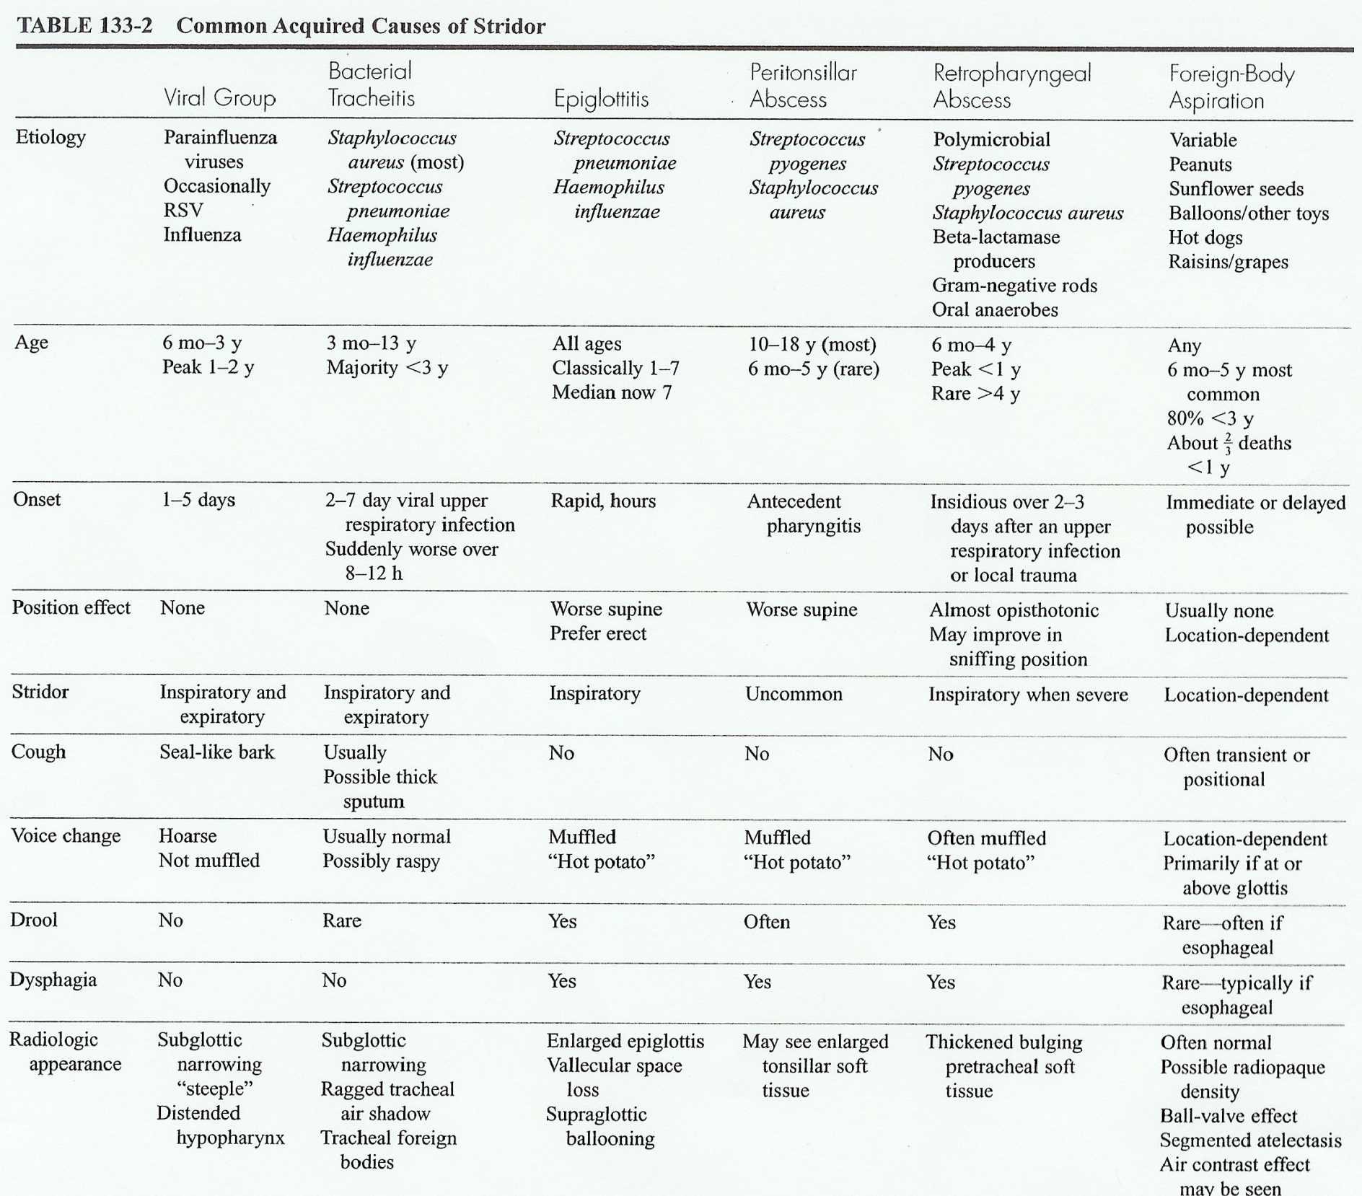

Slide 46
I.Viral Croup (laryngotracheobronchitis)
Most common cause of stridor after neonatal period
Most affected are children 6 mo.- 3 y.o
Peak incidence between 1-2 yrs of age
Narrowest part of airway is at cricoid cartilage and in children 1 mm of airway edema may ↓ cross-sectional area 50-60%
Most cases occur cold season

Slide 47
SPASMODIC CROUP
Thought to be on continuum with acute viral croup
Seen more commonly in atopic children
No seasonal variation
Usually resolves within 6 hours of onset
Often recurrent and not associated with fever

Slide 48
VIRAL CROUP
Etiology-mostly viral
Parainfluenza virus type I,II,III
Incubation 2-6 days, virus shed for about 2 weeks
Others
Influenza A or B, RSV, rhinovirus, and measles
Adenovirus- also hemorrhagic cystitis, and conjunctivitis
Mycoplasma pneumoniae may present with croup like syndrome

Slide 49
VIRAL CROUP
Signs & Symptoms
1-5 day prodrome of cough, coryza, +/- low grade fever and URI type symptoms
Followed by 3-4 days of barking cough, worse in late evening and night
+/- biphasic stridor: inspiratory component greater than expiratory. Unaffected by position, worsened by agitation or crying
Duration 3-7 days regardless of tx, usually 3rd and 4th days are worst, followed by improvement

Slide 50
VIRAL CROUP
Diagnosis- made clinically
X-rays: If other causes being considered or in atypical or prolonged cases
Obtain lateral neck films and PA CXR
PA CXR in croup “steeple sign”

Slide 51
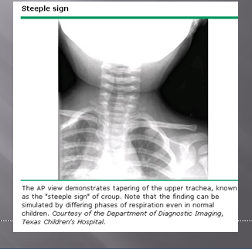

Slide 52
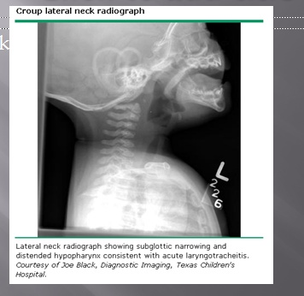

Slide 53
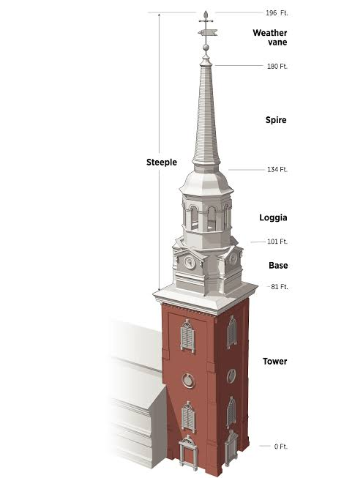
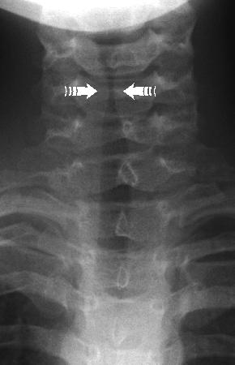
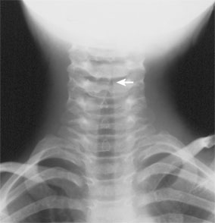
STEEPLE SIGN

Slide 54
The modified Westley clinical scoring system for croup Inspiratory stridor: Not present - 0 points When agitated/active - 1 point At rest - 2 points Intercostal retractions: Mild - 1 point Moderate - 2 points Severe - 3 points Air entry: Normal - 0 points Mildly decreased -1 point Severely decreased - 2 points Cyanosis: None - 0 points With agitation/activity - 4 points At rest - 5 points Level of consciousness: Normal - 0 points Altered - 5 points Total Possible Score 0-17: <2=mild croup, 3-7=moderate croup, >8/=severe croup, >/12=Impending respiratory failure

Slide 55
Management of croup
Mild croup – home treatment , use steam
Moderate to severe cases (progressive stridor, restlessness, cyanosis, pallor or depressed sensorium)
Admission
Avoid disturbing the pt. as much as possible
Give parenteral fluids
Give oxygen

Slide 56
Racemic epinephrine(0.25-0.75ml 2.25% max 0.5ml)in3ml of NS q 20 min
Steroids
Reduce inflammatory edema
0.6mg/kg im single dose
nebulized budesonide
Antibiotics not indicated
Artificial airway for severe cases

Slide 57
II. EPIGLOTTITIS
Causative Organisms
H. influenza < 25% secondary to vaccinations
Strep pyogenes and pneumonie
Staph aureus
Immunocompromised patients
Herpes simplex, candida, varicella
Prior to H. Flu vaccination median age was 3 years—currently age 7

Slide 58
EPIGLOTTITIS
Classic symptoms- abrupt onset of high fever, sore throat, dysphagia, and drooling, +/- stridor. Usually no cough
Some cases may develop over days
Toxic-appearing, apprehensive, often sits in tripod or “sniffing” position, voice may be muffled, marked tenderness with palpation of hyoid

Slide 59
EPIGLOTTITIS
Dx- lateral XR unnecessary for classic s/s
If uncertain dx – lateral XR of soft tissues with neck extended during inspiration
False (+) if XR with head flexed or in expiration
If False (-) direct visualization needed
X Rays- epiglottis is swollen “thumbprint” at the base of the hypopharynx
Commonly vallecular space obscured
Supraglottic ballooning

Slide 60
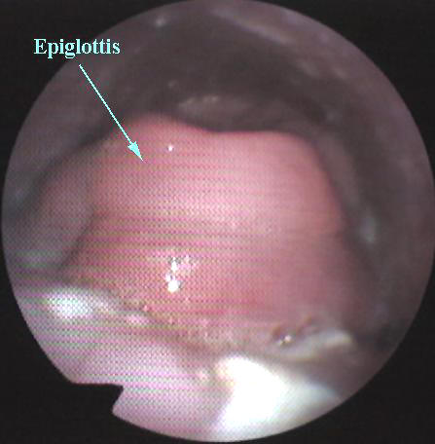

Slide 61
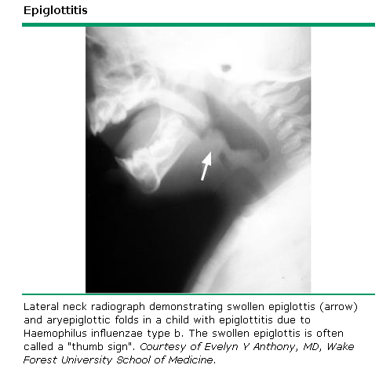

Slide 62
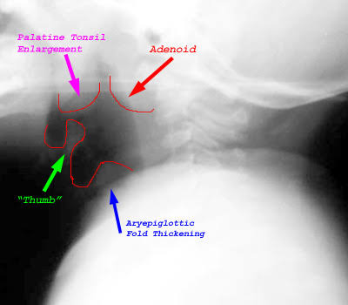
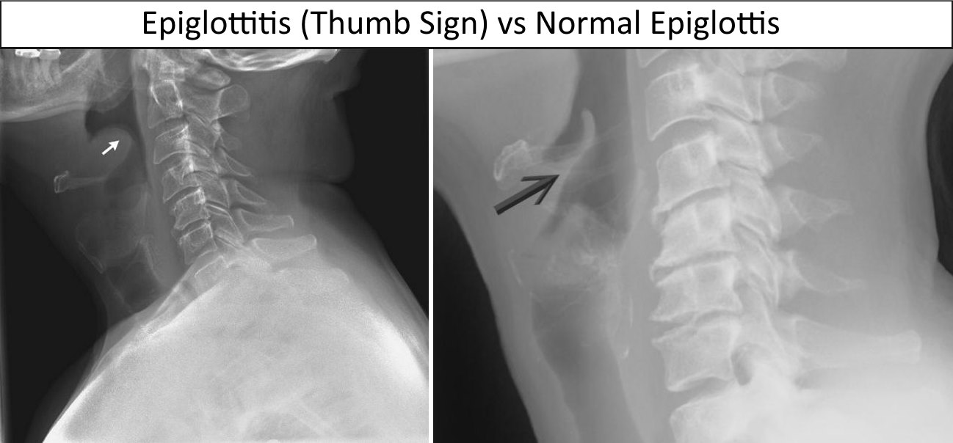
THUMB SIGN

Slide 63
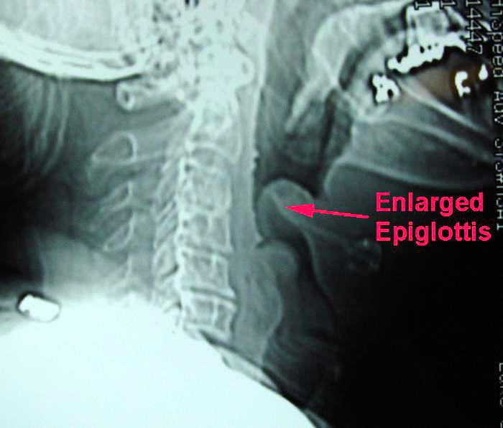

Slide 64
Management of Epiglottitis
A medical emergency, needs immediate artificial airway
- A child with confirmed epiglottitis should be intubated
Recemic epinephrine and corticosteroids are not effective
Blood culture ,epiglottic surface, should be collected
Antibiotics against H.influenzae type b for 7-10 days
2nd or 3rd cephalosporin +/- vancomycin

Slide 65
III. BACTERIAL TRACHEITIS
Often caused by bacterial superinfection of antecedent viral upper respiratory infection
Most common in children <3 yrs
Signs & Symptoms
2-7 days of croup like syndrome
Then worsening symptoms & toxic appearance
Severe inspiratory & expiratory stridor
Cough w/ occasional thick sputum
Rough / hoarse voice, no dysphagia
May complain of troubling/ burning substernal chest discomfort

Slide 66
BACTERIAL TRACHEITIS
Diagnosis
Most w/ ↑ WBC and left shift
XR- subglottic narrowing of trachea +/- irregular densities w/in trachea, borders appear indistinct
Management - Similar to epiglottitis- 85 % require intubation
Treatment- Vancomycin and 3rd generation cephalosporin

Slide 67
Foreign Body Obstruction
Infants and toddlers use their mouths to explore their surroundings.
Children, younger than 3 yr of age, account for 73% of cases. After finger grasp started 9month
Rare cause of obstruction
Onset is usually sudden
Features dependent on where lodged

Slide 68
C/M
Depends on the site
Trachea
chocking ,stridor sever distress ,cough , absent air entry or wheeze bilaterally
Bronchial Foreign Bodies
stop valve effect : atelectasis and mediastina shift to the foreign body side
Ball valve :hyperinflation and mediastinal shift to the opposite to fB site

Slide 69
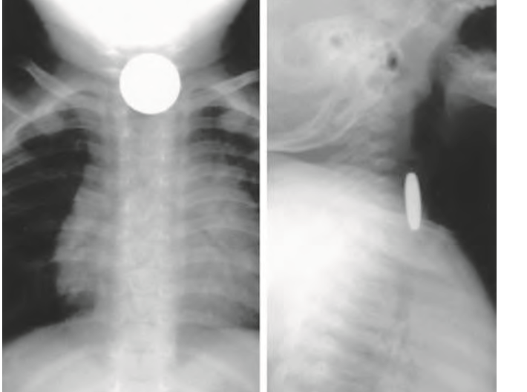
X ray of foreign body in the esophagus
Typical xray of foreign body in the esophagus and the opposite occur in the trachea

Slide 70
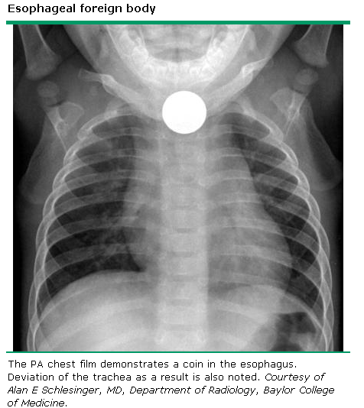

Slide 71
Management of the choking infant
Lay infant on your arm in head down position
Give 5 blows to the infants back with heel of hand
If obstruction persists turn over and give 5 chest thrusts with 2 fingers 1 finger breadth below nipple level in midline
If obstruction persists check infants mouth for any object which can be easily removed
If necessary repeat sequence with back slaps again

Slide 72
Management of the choking infant

Slide 73
Management of Choking Child
Give 5 blows to the child’s back with heel of hand with child sitting, kneeling or lying
If obstruction persists, go behind the child and pass your arms around the child’s body: form a fist with one hand immediately below the child’s sternum; place the other hand over the fist and pull upwards into the abdomen; repeat this Heimlich manoeuvre 5 times
If the obstruction persists, check the child’s mouth for any obstruction which can be removed
If necessary repeat sequence with back slaps again

Slide 74
Management of Choking Child

Slide 75
Cont... Managment
1) If <1 year old, use back blows/chest compressions
2) If > 1 year old, use Heimlich maneuver
3) If foreign body not expelled by above, perform laryngoscopy and remove visible foreign body with pediatric Magill forceps
4) If foreign body not visualized, attempt to intubate
5) If child cannot be intubated, needle cricothyroidotomy
should be attempted

Slide 76
Questions?

Slide 77
Thank you!!!

Slide 78
READING ASSIGNMENT
Congenital lung malformation.

